Slide 1

8th Grade Math
Unit 8, Lesson 3 Solving Equations with Variables on Both Sides Volume 2, pg. 16

Slide 2


Benchmark
MA.8.AR.2.1
Solve multi-step linear equations in one variable, with rational number coefficients. Include equations with variables on both sides.
volume 2, pg. 16

Slide 3
Integrated Mathematical Thinking and Reasoning Standards
MA.K12.MTR.1.1 Actively participate in effortful learning both individually and collectively.
MA.K12.MTR.3.1 Complete tasks with mathematical fluency.
MA.K12.MTR.4.1 Engage in discussions that reflect on the mathematical thinking of self and others.
MA.K12.MTR.6.1 Assess the reasonableness of solutions.
volume 2, pg. 16

Slide 4

Learning Target
I can solve equations with variables on both sides.
volume 2, pg. 16

Slide 5

Warm-Up
volume 2, pg. 17

Slide 6
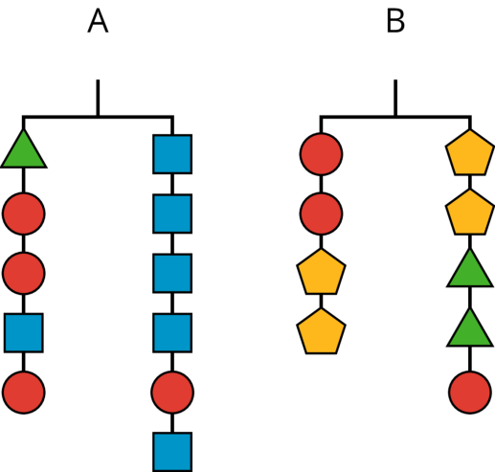
8.3.1 Warm-Up: Balancing Hangers
The picture represents two balanced hangers. The hangers are balanced because the weight on each side is the same.
volume 2, pg. 17

Slide 7
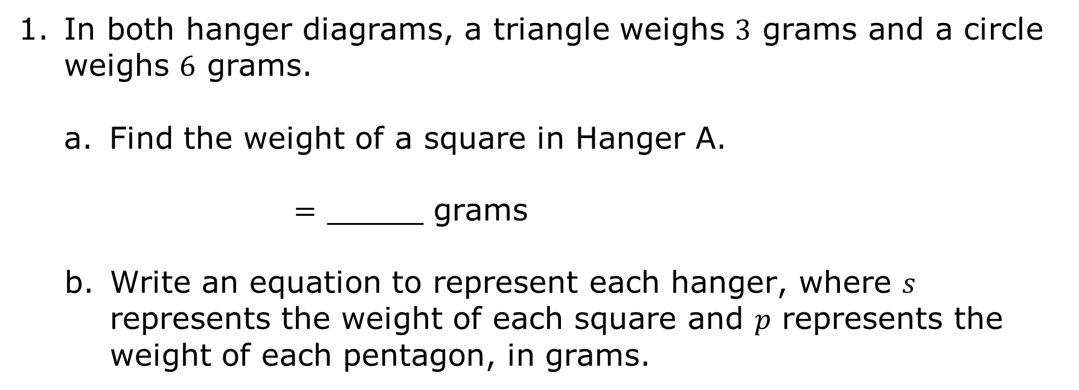
In both hanger diagrams, a triangle weighs $3$ grams and a circle weighs $6$ grams.
Find the weight of a square in Hanger A.
$=$ _____ grams
Write an equation to represent each hanger, where $s$ represents the weight of each square and $p$ represents the weight of each pentagon, in grams.
Hanger | Equation
A
B
volume 2, pg. 17

Slide 8

Exploration
volume 2, pg. 17

Slide 9

8.3.2 Exploration: Equations with Variables on Both Sides
Similar to hanger diagrams, algebra tiles can be used to model equations. As seen in the Warm-Up, it is possible to have linear equations with variables on both sides of the equal sign.
Work with your partner to use algebra tiles to explore how to solve such equations.
volume 2, pg. 17

Slide 10
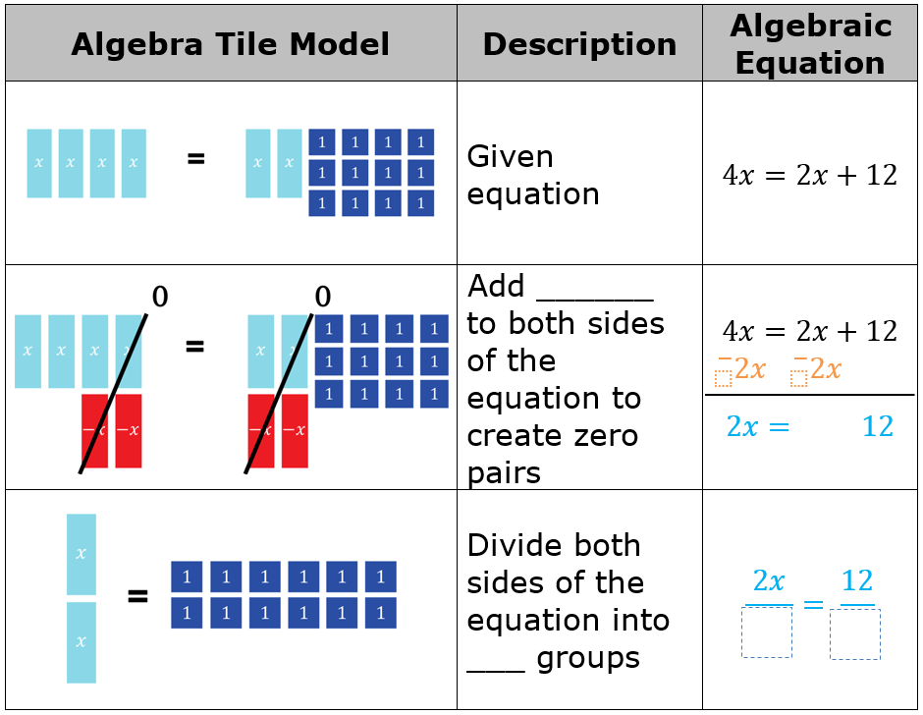
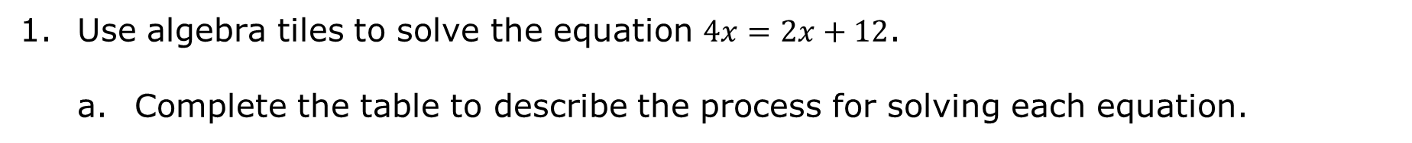
Use algebra tiles to solve the equation $4x=2x+12$.
Complete the table to describe the process for solving each equation.
volume 2, pg. 17

Slide 11
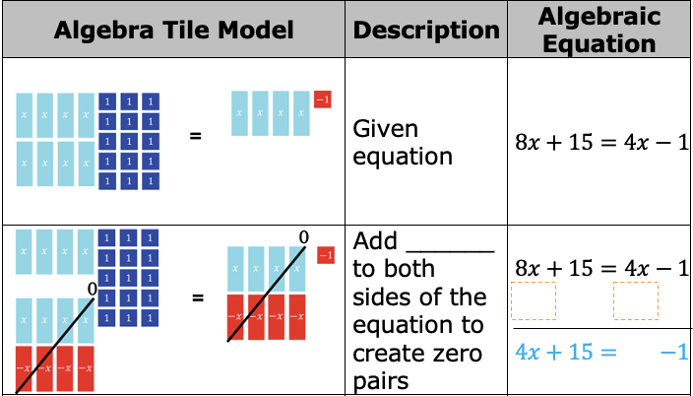
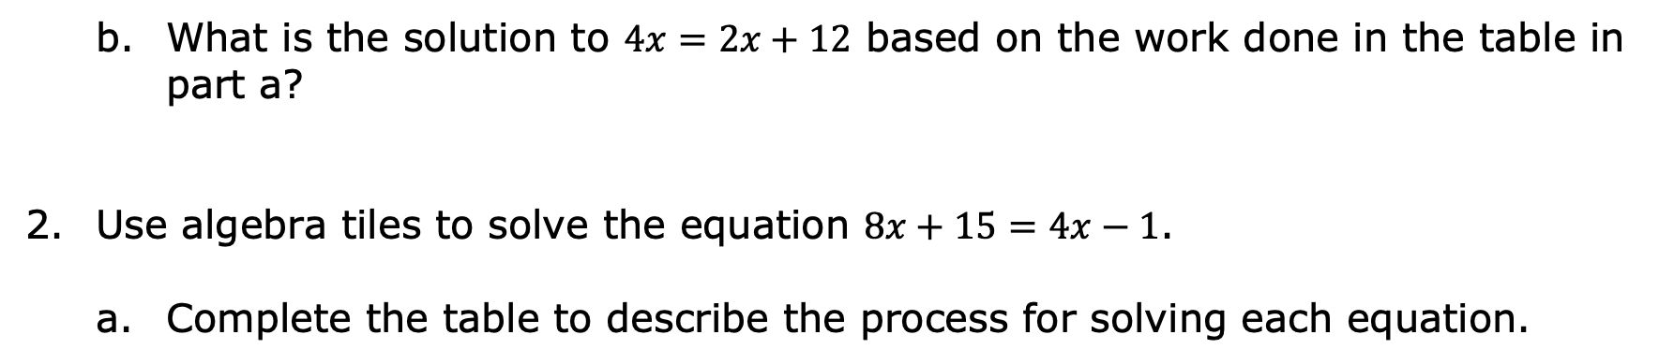
What is the solution to $4x=2x+12$ based on the work done in the table in part a?
Use algebra tiles to solve the equation $8x+15=4x−1$.
Complete the table to describe the process for solving each equation.
volume 2, pg. 18

Slide 12
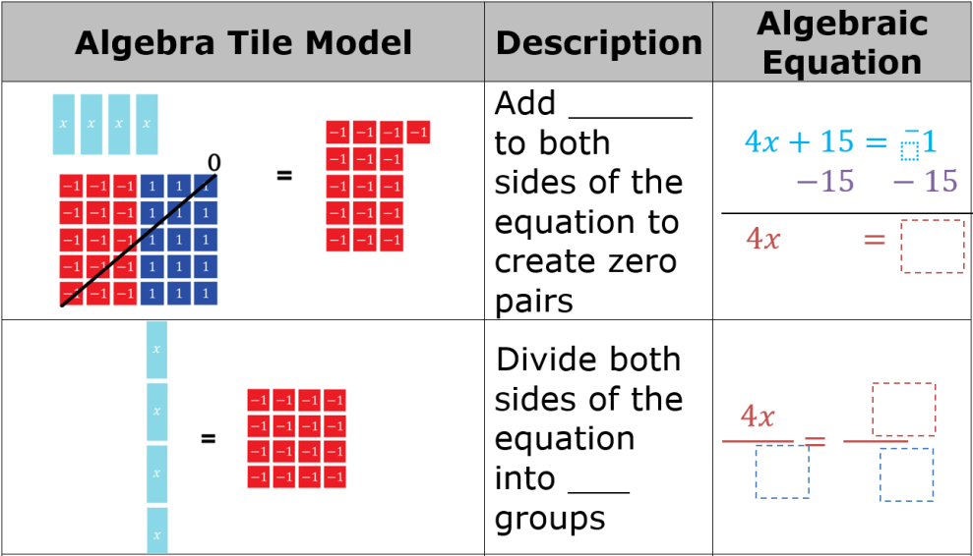
What is the solution to $8x+15=4x−1$, based on the work done in the table in part a?
volume 2, pg. 18

Slide 13
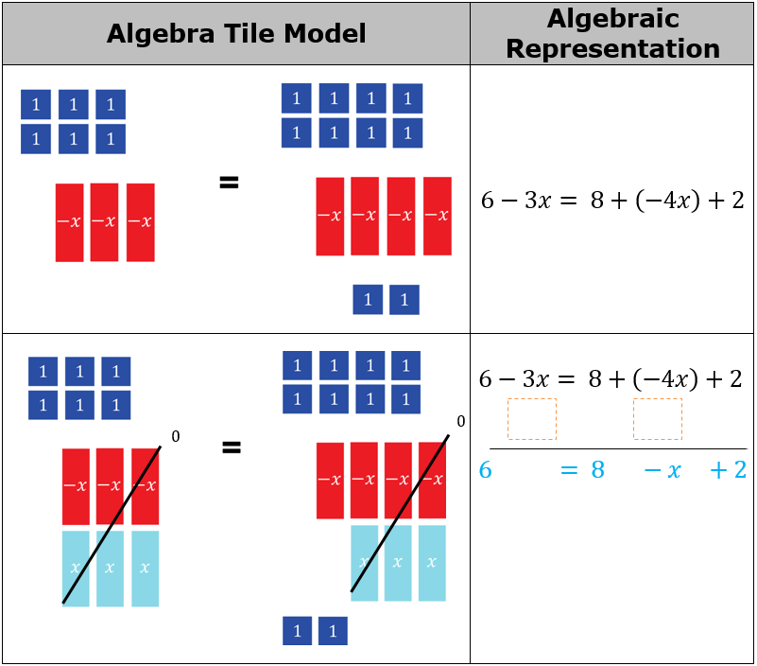
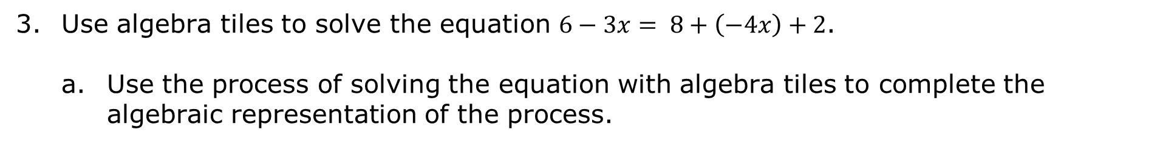
Use algebra tiles to solve the equation $6−3x= 8+\left(−4x\right)+2$.
Use the process of solving the equation with algebra tiles to complete the algebraic representation of the process.
volume 2, pg. 18

Slide 14
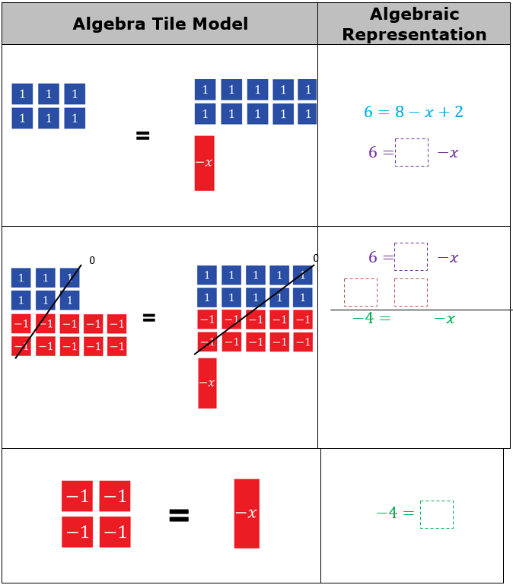
volume 2, pg. 19

Slide 15
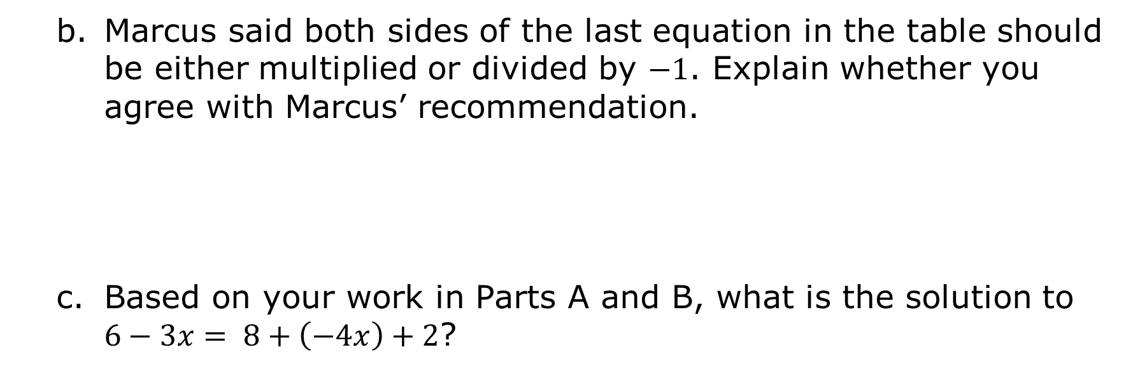
Marcus said both sides of the last equation in the table should be either multiplied or divided by $−1$. Explain whether you agree with Marcus’ recommendation.
Based on your work in Parts A and B, what is the solution to $6−3x= 8+\left(−4x\right)+2$?
volume 2, pg. 19

Slide 16
Discuss with your partner the similarities and differences between solving equations with variables on only one side and solving equations with variables on both sides. Record similarities and differences discussed.
Similarities | Differences
volume 2, pg. 19

Slide 17

Guided Instruction
volume 2, pg. 20

Slide 18
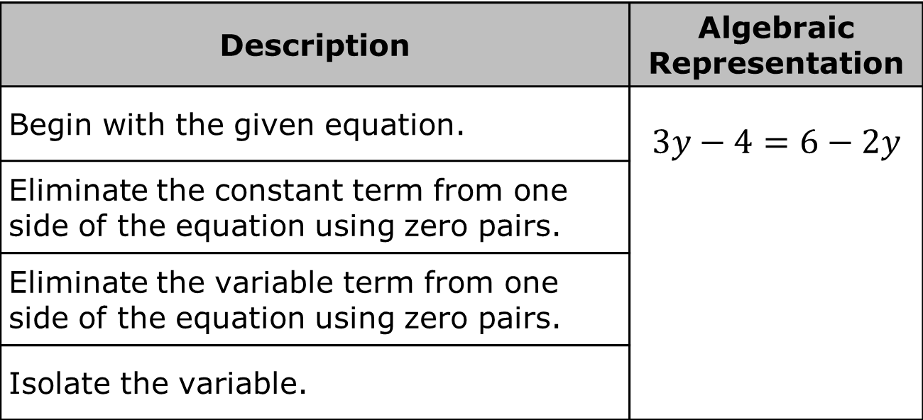
8.3.3 Guided Instruction: Solving Equations with Variables on Both Sides
Solve the equation $3y−4=6−2y$ by following the steps described in the table.
Description | Algebraic Representation
Begin with the given equation. | $$3y−4=6−2y$$
Eliminate the constant term from one side of the equation using zero pairs.
Eliminate the variable term from one side of the equation using zero pairs.
Isolate the variable.
volume 2, pg. 20

Slide 19
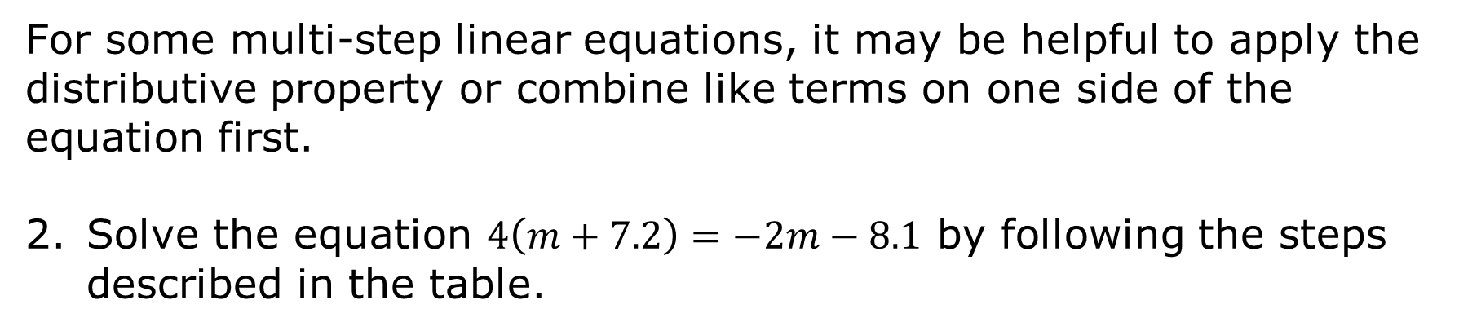
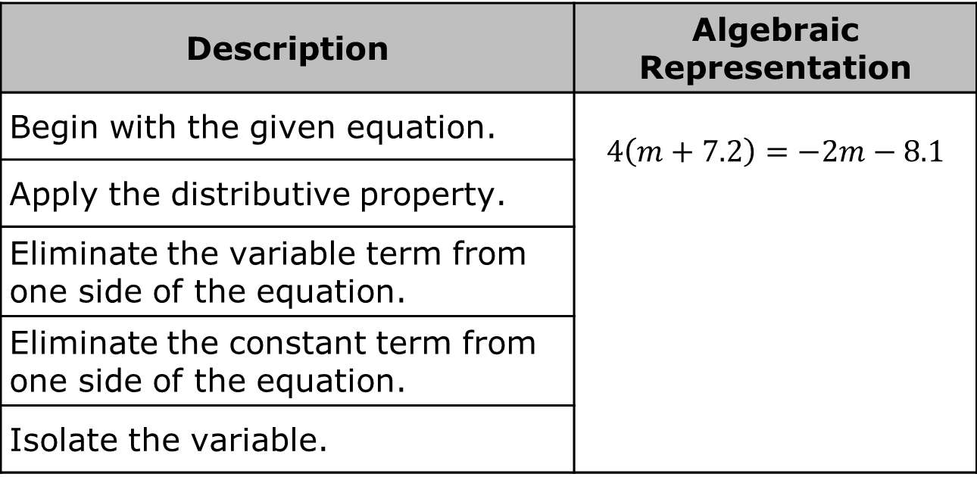
For some multi-step linear equations, it may be helpful to apply the distributive property or combine like terms on one side of the equation first.
Solve the equation $4\left(m+7.2\right)=−2m−8.1$ by following the steps described in the table.
Description | Algebraic Representation
Begin with the given equation. | $4\left(m+7.2\right)=−2m−8.1$
Apply the distributive property.
Eliminate the variable term from one side of the equation.
Eliminate the constant term from one side of the equation.
Isolate the variable.
volume 2, pg. 20

Slide 20
Solve the equation $−12p+3p−11=14−3p−7$.
volume 2, pg. 20

Slide 21

Your Turn
volume 2, pg. 21

Slide 22
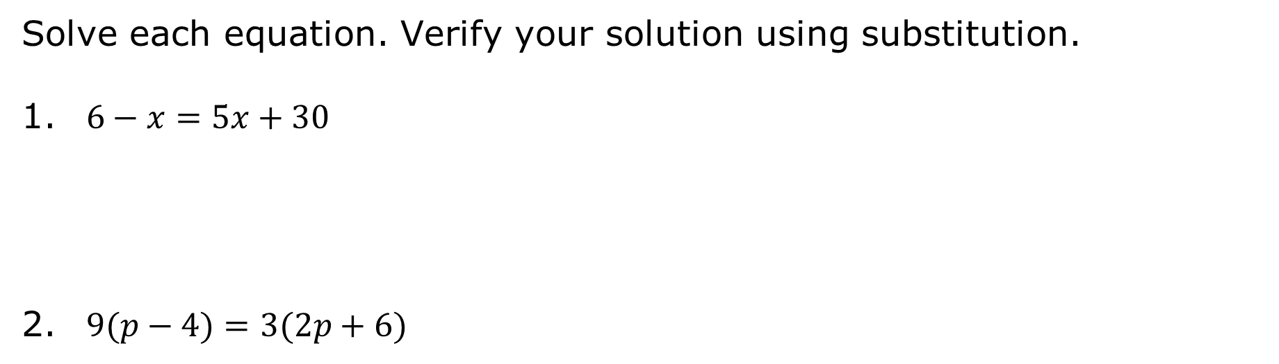
8.3.4 Your Turn!
Solve each equation. Verify your solution using substitution.
$6−x=5x+30$
$9(p−4)=3(2p+6)$
volume 2, pg. 21

Slide 23

Wrap-Up
volume 2, pg. 21

Slide 24
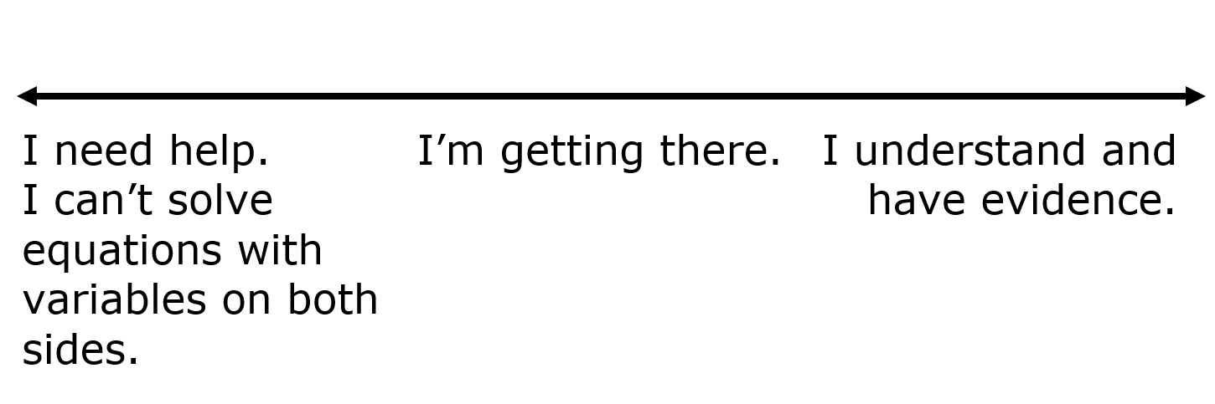
8.3.5 Wrap-Up: Reflection
Draw an X on the line to indicate how you feel about today’s learning target.
I can solve equations with variables on both sides.
Explain your placement of “X” on the scale.
volume 2, pg. 21

